Slide 1
Elementary school “Slavinovici”
Bosnia and Herzegovina
Federation of Bosnia and Herzegovina
TUZLA CANTON
Prepared by:
Tea Šarić i Denis Stankić-students, Fatima Odžaković- school pedagogue, Senada Muratbegović, Dijana Kovačević, Almirdina Gardaš, Mirela Ahmetović, Mirela Grbešić i Enisa Isović-teachers.

Slide 2
DENIS TEA

Slide 3
The elementary school “Slavinovici” has celebrated its seventieth birthday this year. The school is considered among the groups of those with the longest tradition in Tuzla. If it were a human being, it would be a feeble, elderly woman with wrinkled face and slow, fatigued movements. However, our school is everything else but not fatigued and feeble. It is vivid, full of children’s’ clamor and joy. It is eternally young thanks to the generations who shared their childish dreams and hopes with it, the generations of erudite youth who have woven their youthful ideas into it, and, in contrary, they have got the foundations of good education and the wings to fly leaving their nests.

Slide 4
The teaching process in our school is organized in a pleasant school climate, following the interactive principles (active approach to the teaching process, the student as a center of activity), the principle of inclusion (including students with difficulties in regular teaching process), as well as the principles of continued development which respects all sorts of diversities as a great potential. The relations among the individuals at school are based on the principles of The Children’s Right Convention respecting the stances, culture and tradition of all students and employees.

Slide 5
There are 447 students in the school year 2015/16, grouped into 18 classes. The structure of students is multiethnic and multicultural. The teaching process is led by 32 educated and professional teachers and professors.

Slide 6
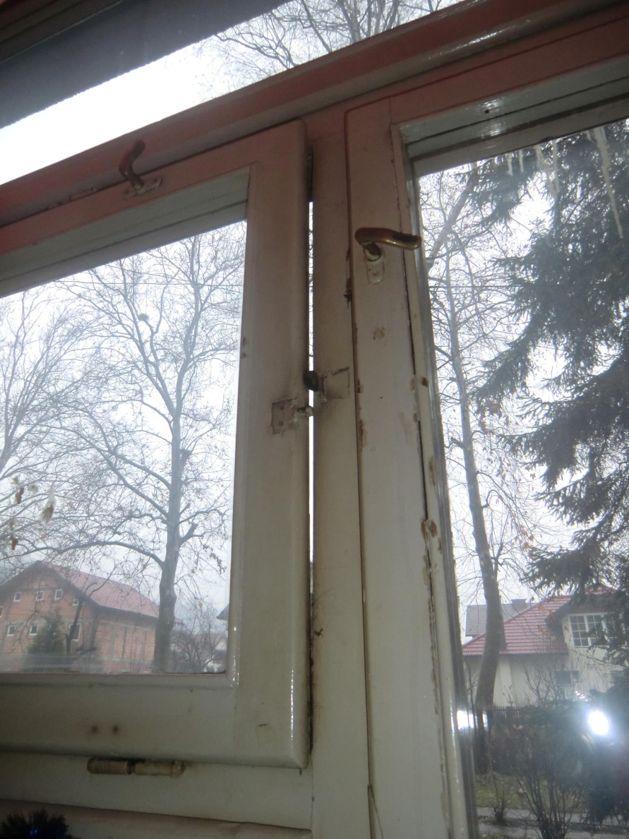
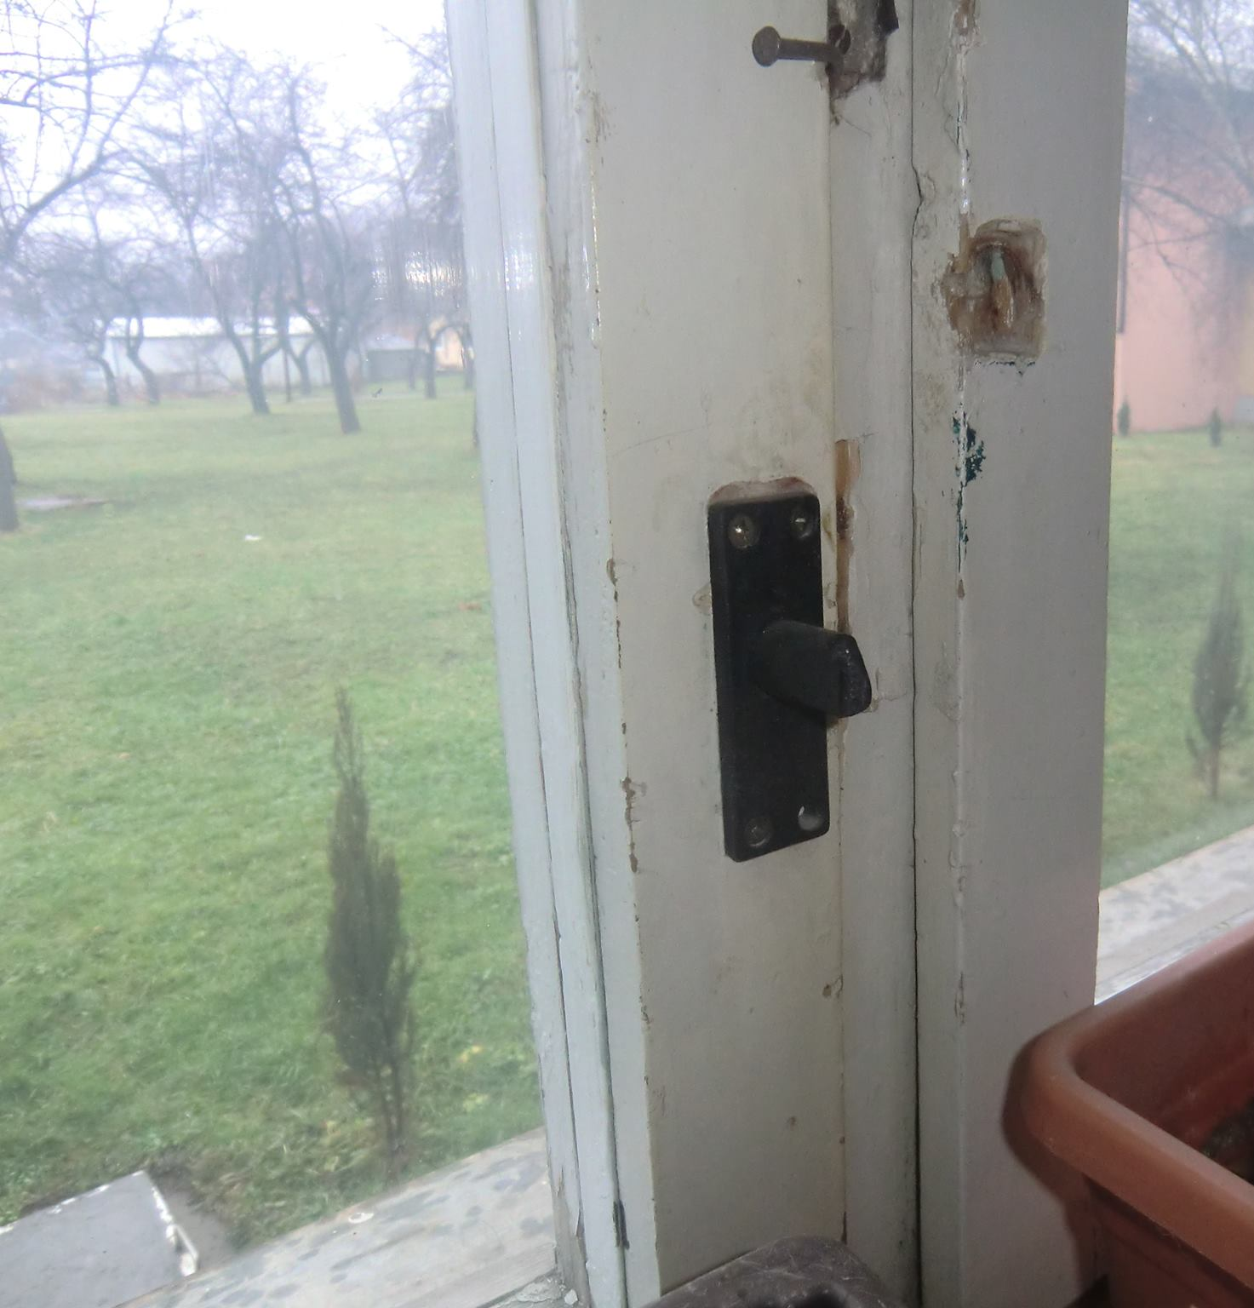
In order to enter the building one has to pass through a picturesque orchard, which is covered by the bloom in spring, and, in summer, it is bathed in sun and covered by the scent of juicy, rosy apples. It is not a strange thing the school was rightfully given a nickname “The beauty from the suburbs”. The song of resonant children’s voices welcomes every visitor, and the cheerful faces of the toothless first-graders irresistibly attract you to return the affectionate smile.

Slide 7
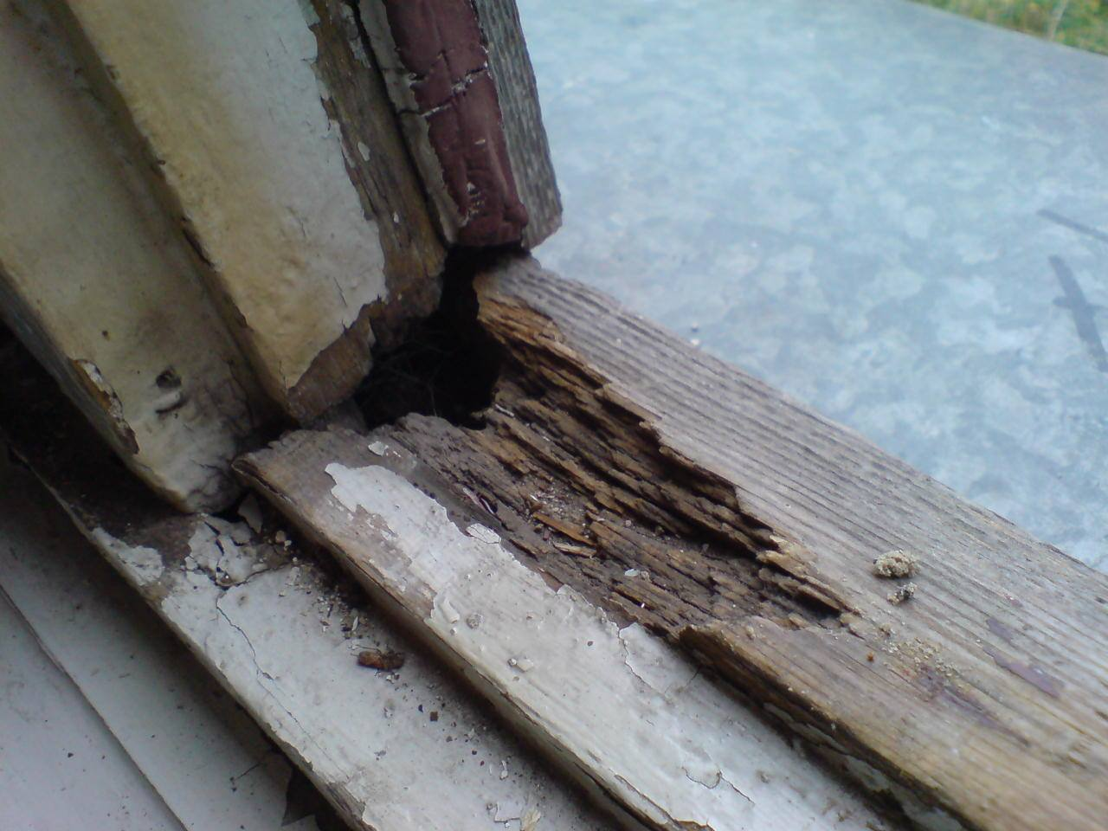
Our old school has motherly embraced all children, and it keeps and protects them in its warm arms, but, in winter, when the cold winter winds start blowing and when the frost covers the sleepy nature with its icy coat, the warm classrooms turn into little refrigerators.

Slide 8
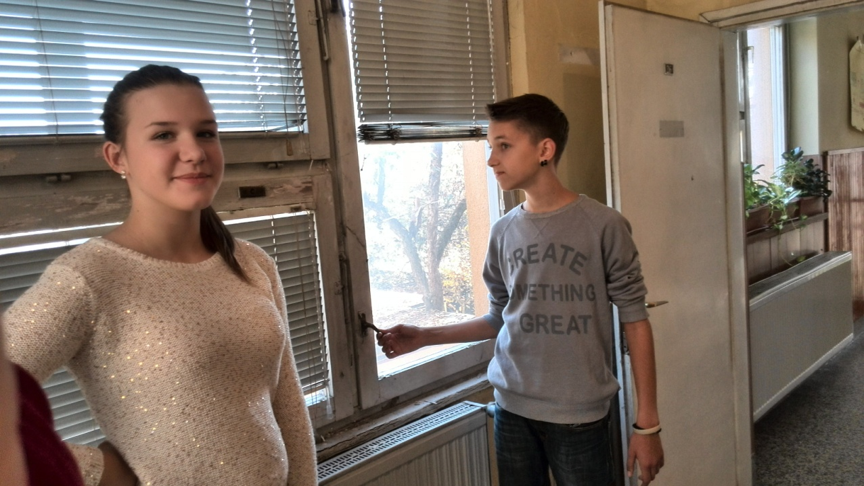
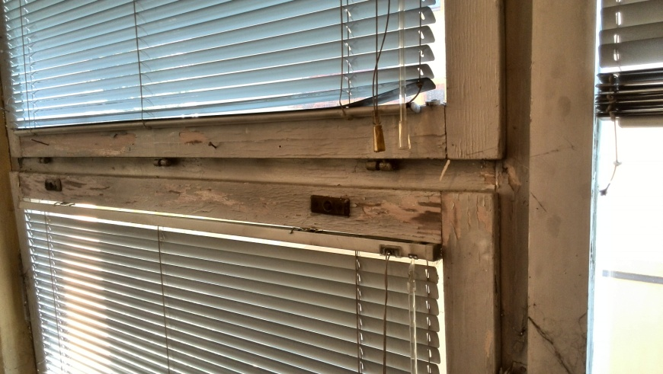
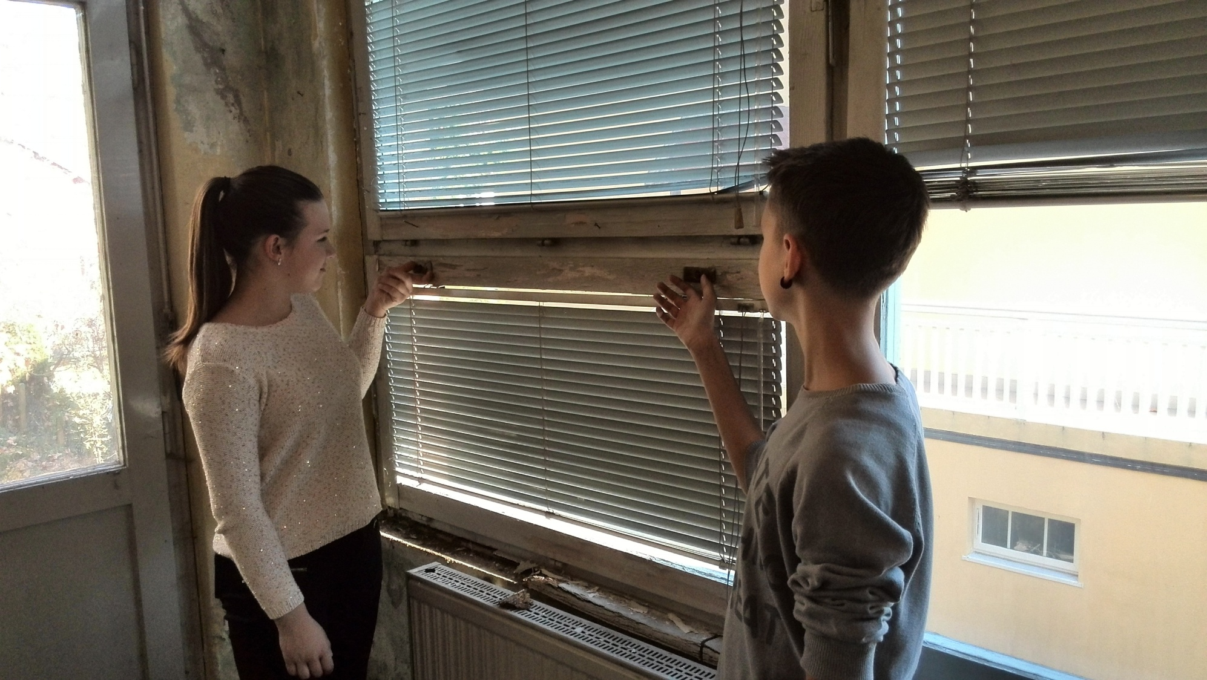
In summer, the classrooms are unbearable warm and it is hard to defend from the heat since the windows cannot open. You will wonder – Why? We’ll tell you a reason why – the school windows are old. For a number of years, they have been washed down by abundant fall rains, covered with snow, decorated by frosts, and dried by summer heat, so they started giving up their struggle to protect the students from the winter cold and summer heat. Just imagine – some windows had to be nailed in order not to fall on little, tender and smart children’s heads. Our teachers keep warning up not to touch windows for our own safety.

Slide 9
In winter, we move away from the windows, running away from the cold wind that makes draft and blows through them, and at the beginning or at the end of the school year we cannot run away from the summer heat. It is not easy to be concentrated and take lessons when the stuffiness rules over in classrooms, and the nailed windows will not let any breeze of freshness come in. Then we frequently open the classroom doors to breathe normally, as much as it is possible. And, while doing that, we sadly look at our nailed school windows.

Slide 10
The beautiful it is, dear it is – our school. We are proud of its long tradition and results which we persistently achieve in numerous competitions.

Slide 11
THE END

